Slide 1
Convergence check for diff algorithms
print((L[n_iter-1]-L[n_iter-2])/L[n_iter-1])
print(np.max(abs(ws[n_iter-1]-ws[n_iter-2])))
print(L[n_iter-1])

Slide 2
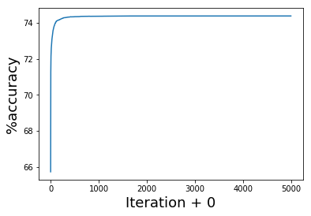
GD, 5000 iter, st_size=0.625
74.3848

Slide 3
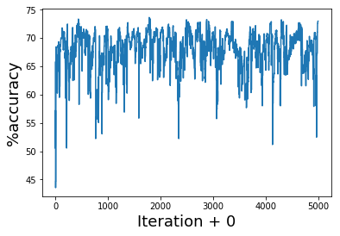
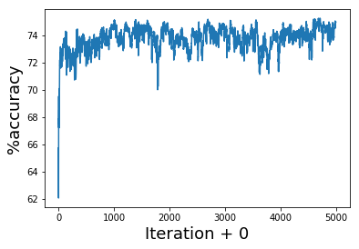
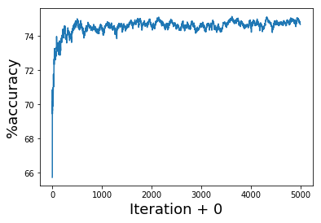
SGD, 1 sample, 5000 iter, st_size same
once
10 times average
100 times average
73.628
75.2352
75.154

